Slide 1
SMART DOORBELL USING IoT (ESP32 Camera Module)
Team members:
B.Faneesh (44111354,E3)
B.Siva Teja (4411149,E3)
Snehan Reddy (44111334,E3)
G.Tharak Reddy (44111355,E3)
C.Sai Kiran(44111369,E3)
Guide
Ms.Bhanu Shree.M.E(PhD),
Assistant Professor

Slide 2
PROBLEM STATEMENT
Traditional doorbells do not provide information about who is at the door when the user is away. This can lead to missed visitors and security concerns.
Identify visitors when the homeowner is away.
Provide a visual record of security incidents or "porch piracy."
Facilitate interaction without opening the door, which poses a safety risk.

Slide 3
RECENT YEAR (ANY 2) PROBLEM STATEMENT
Case 1: Package Theft Surge (2024): A significant rise in suburban package thefts highlighted the need for motion-triggered video alerts that notify users before the thief leaves the premises.
Case 2: Unauthorized Entry Attempts (2025): Recent security audits show that "door knocking" is a common tactic used by burglars to check for house occupancy; a smart system creates the illusion of presence by allowing remote responses.

Slide 4
SOLUTIONS
The proposed system utilizes an ESP32-CAM integrated with a cloud platform. It captures real-time images upon a button press or motion detection and transmits them to a smartphone. It also includes a Relay Module to allow the homeowner to remotely operate an electronic door strike or auxiliary security light.

Slide 5
KEY POINTS
Real-time Alerts: Instant push notifications via Wi-Fi.
Remote Access: Monitor your front door from anywhere in the world.
Low Cost: Built using affordable, off-the-shelf IoT components.
Dual-Action: Combines surveillance (Camera) with control (Relay).

Slide 6
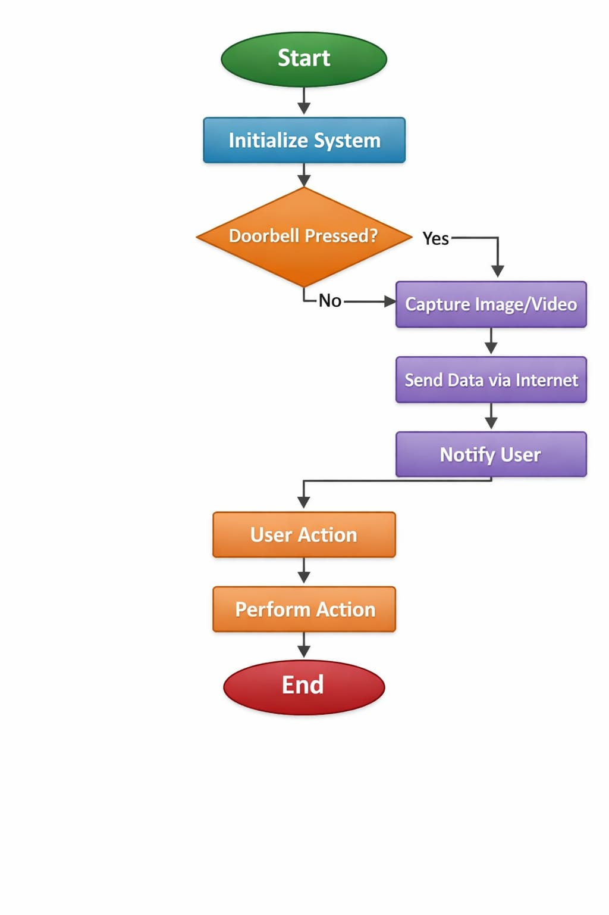
FLOWCHART

Slide 7
FLOWCHART - Explanation
1.Start
The system is powered ON using the 5V mobile charger.
2. Initialize System
ESP32-CAM initializes all components:
Camera module
Wi-Fi connection
Push button (doorbell)
Relay module
3. Doorbell Pressed?
The system continuously checks whether the push button is pressed.
❌ If NO → keep waiting
✅ If YES → move to the next step
4. Capture Image
When the button is pressed:
ESP32 Camera captures an image of the visitor.
5. Send Data via Internet
Captured image is sent through:
Wi-Fi
Cloud server / mobile app (like Blynk, web server)
6. Notify User
The homeowner receives a notification on their mobile:
“Someone is at your door”
Image/video is displayed
7. User Action
User decides what to do:
View live feed
Unlock door / turn ON relay
8. Perform Action
Based on user input:
Relay activates (door unlock / bell / light ON)Or no action is taken

Slide 8
OBJECTIVES
To design a wireless notification system for home entrances.
To implement a cloud-based communication protocol for remote image viewing.
To provide a secure method for remote door access via a relay interface.

Slide 9
METHODOLOGY
Hardware Interfacing: Connecting the Push Button and Relay to the ESP32 GPIO pins on a breadboard.
Network Configuration: Configuring the ESP32 to connect to a local Wi-Fi gateway.
Protocol Implementation: Using HTTP or MQTT protocols to transmit image data to a mobile application/web dashboard.
Power Management: Utilizing a 5V/1A mobile charger for stable operation.

Slide 10
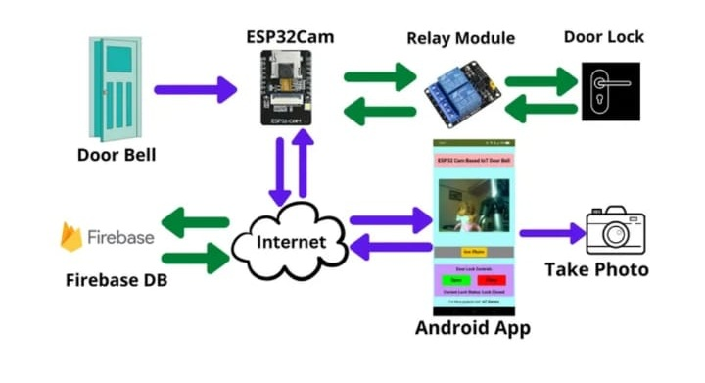
MODEL SECTION AND TRAINING

Slide 11
DATA INPUT
The system processes three primary types of input:
Physical Trigger: Push button signal (High/Low) via GPIO pins.
Visual Data: Image/Video stream captured by the ESP32-CAM.
Sensor Data: Motion detection (if using PIR) or state change via the push button.

Slide 12
MILESTONES
Selection of project topic and system architecture design.
Interfacing doorbell button/IR sensor with Integration of camera.
Cloud connectivity setup for data transfer.
Mobile application integration for alerts and control.
Testing real-time notifications and video streaming.
Final testing and project demonstration.

Slide 13
OUTCOMES
Successful visitor detection.
Real-time image/video capture of visitors.
Instant notification sent to the user's smartphone.
Remote door access and monitoring achieved.

Slide 14
Simulation Result and output
The system was tested by simulating visitor presence using button press and motion detection. Upon detection, the camera captured the visitor's image/video and uploaded it to the cloud. A real-time notification was sent to the user's mobile application. The user was able to view the visitor, communicate through two-way audio, and perform remote actions such as granting or denying access, confirming proper system operation.

Slide 15
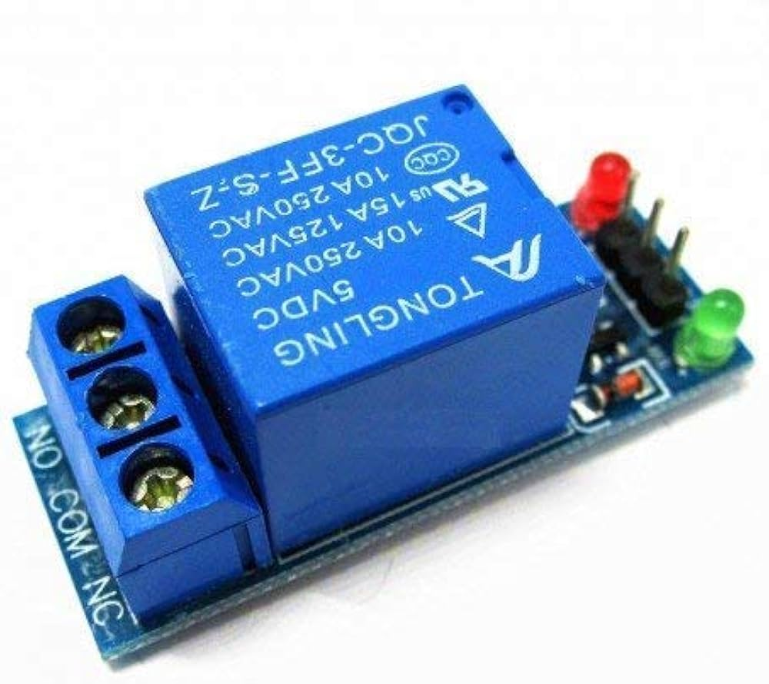
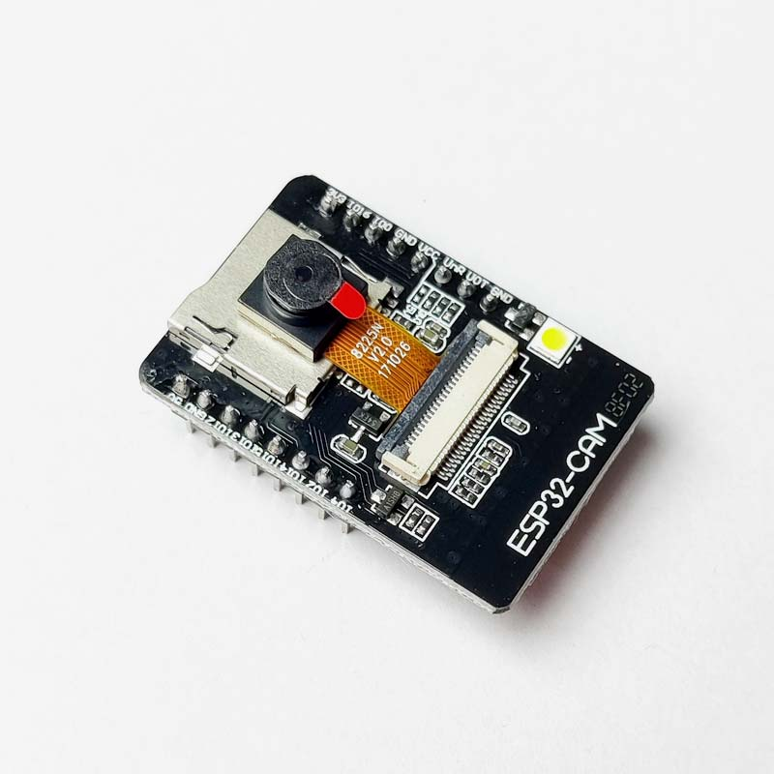
Hardware photos
ESP32 Camera Module
Single channel Relay Module

Slide 16
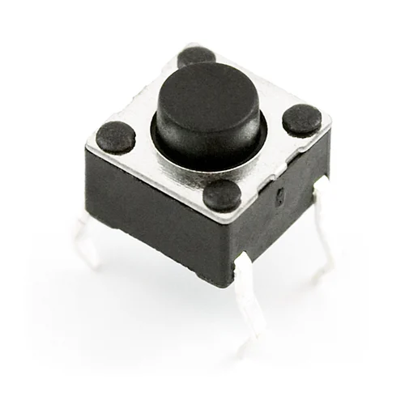
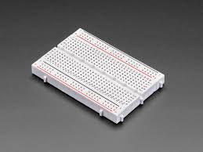
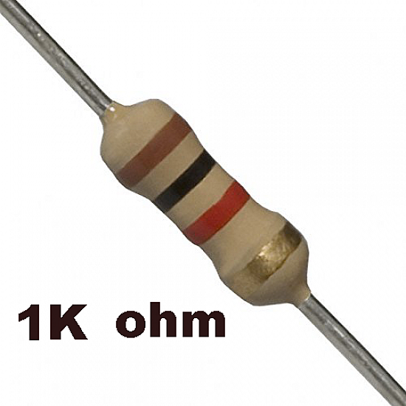
Hardware photos
Push Button Switch
Breadboard Resistor 1KQ x 1

Slide 17
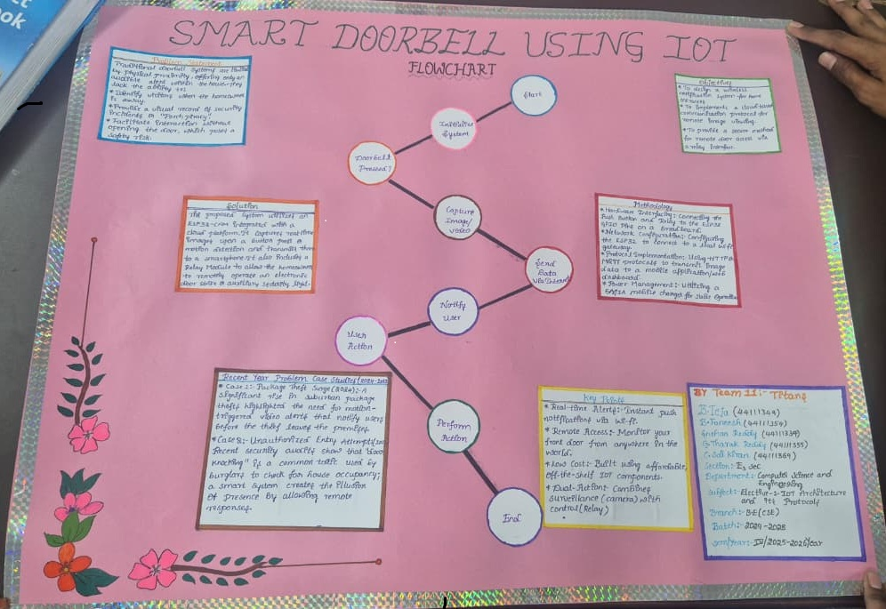
Chart work photos

Slide 18
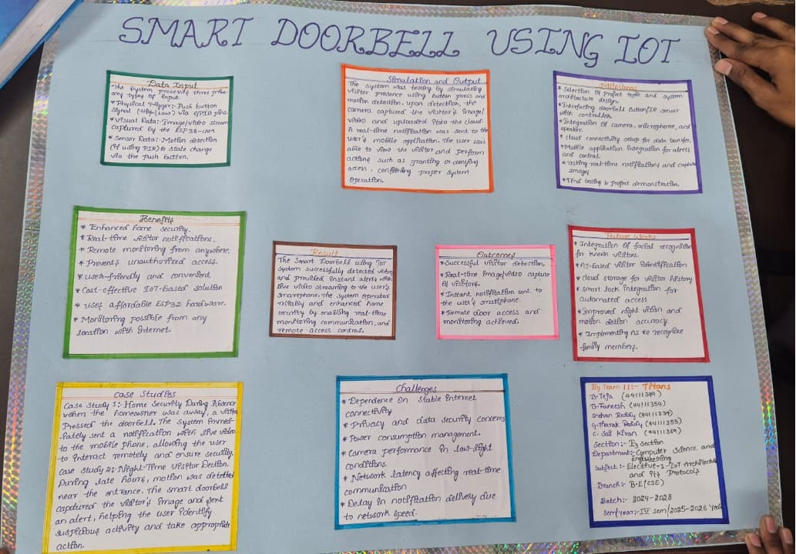
Chart work photos

Slide 19
RESULT
The Smart Doorbell using lot system successfully detected visitors and provided instant alerts with live video streaming to the user's smartphone. The system operated reliably and enhanced home security by enabling real-time monitoring, communication, and remote access control.

Slide 20
CASE STUDIES
Case Study 1: Home Security During Absence
When the homeowner was away, a visitor pressed the doorbell. The system immediately sent a notification with live video to the mobile phone, allowing the user to interact remotely and ensure security.
Case Study 2: Night-Time Visitor Detection
During late hours, motion was detected near the entrance. The smart doorbell captured the visitor's image and sent an alert, helping the user identify suspicious activity and take appropriate action.

Slide 21
BENEFITS
Enhanced home security
Real-time visitor notifications
Remote monitoring from anywhere
Two-way audio communication
Prevents unauthorized access
User-friendly and convenient
Cost-effective IoT-based solution

Slide 22
CHALLENGES
Dependence on stable internet connectivity
Privacy and data security concerns
Power consumption management
Camera performance in low-light conditions
Network latency affecting real-time communication

Slide 23
FUTURE WORK
Integration of facial recognition for known visitors
Al-based visitor identification
Cloud storage for visitor history
Smart lock integration for automated access
Improved night vision and motion detection accuracy

